Slide 1
Chapter 8-1
Subroutines
计算系统概论A
Introduction to Computing Systems
（ CS1002A.01）
苗付友
mfy@ustc.edu.cn
2025 Fall
计算机科学与技术学院
School of Computer Science and Technology

Slide 2
Outline
1
1
Review
Review
2
2
From ENIAC to the Stored Program Computer
Subroutines
3
3
A Machine Structure：von Neumann Model
Control Instructions for Subroutines
4
4
Summary
Summary

Slide 3
Abstract Data Types： Data Structures
Up to now, we have processed a single value
  an integer
  a floating point number, or
  an ASCII character
How to store and organize values according some structure for efficient look-up/processing? --data structures
The real world is abstract data types, or more colloquially data structures，far more complex than simple, single numbers. E.g.
  a company’s organization chart
  a list of items arranged in alphabetical order
In this chapter, we will study three abstract data types:
  stacks
  queues
  and character strings

Slide 4
Abstract Data Types： Data Structures
We will write programs to solve problems that require expressing information according to its structure.
Before we get to stacks, queues, and character strings, however, we introduce a new concept that will prove very useful in manipulating data structures: subroutines, or what is also called functions.

Slide 5
Subroutines
A subroutine is a program fragment that. . .
  Resides in user space (i.e, not in OS)
  Performs a well-defined task
  Is invoked (called) multiple times by a user program
  Returns control to the calling program when finished
Virtues
  Reuse code without re-typing it (and debugging it!)
  Divide task into parts (or among multiple programmers)
  Use vendor-supplied library of useful routines that software engineers require when they writes a program
    math library
    square root, sine, and arctangent,etc.

Slide 6
A simple illustration of a part of a program
01; Service Routine for Keyboard Input
02 .ORIG x04A0 ;System call starting address
03
04;START ST R7,SaveR7 ;Save the linkage back to the
05; ;program?
06 ST R1,SaveR1 ;Save the values in the registers
07 ST R2,SaveR2 ;that are used so that they can
08 ST R3,SaveR3 ;be restored before RET
09
10;Output Newline on CRT
11 LD R2,Newline
12 L1 LDI R3,DSR ;Check DDR—is it free?
13 BRzp L1 ;Loop until monitor is ready
14 STI R2,DDR ;Move cursor to new clean line
15;
16;Output “Input a character”
17 LEA R1,Prompt ;Prompt is starting address
18 ;of prompt string
19 Loop LDR R0,R1,#0 ;Get next prompt character
20 BRzp Input ;Check for end of prompt string
21 L2 LDI R3,DSR
22 BRzp L2
23 STI R0,DDR ;Write next character of prompt
24 ;string
25 ADD R1,R1,#1 ;Increment prompt point
26 BRnzp Loop

Slide 7
A simple illustration of a part of a program
27;Input a character from KB
28 Input LDI R3,KBSR ;Has a character been typed?
29 BRzp Input
30 LDI R0,KBDR ;Load it into R0
31
32;Echo the character on CRT
33 L3 LDI R3,DSR
34 BRzp L3
35 STI R0,DDR ;Echo input character to the
36 ;monitor
37;Output Newline on CRT
38 L4 LDI R3,DSR ;Check CRTDR—is it free?
39 BRzp L4
40 STI R2,DDR ;Move cursor to new clean line
41
42;Restore
43 LD R1,SaveR1 ;Service routine done, restore
44 LD R2,SaveR2 ;original values in registers.
45 LD R3,SaveR3 ;
46; LD R7,SaveR7 ;Restore linkage back
47; ;prior to RET
48 RET ;Return to calling program

Slide 8
A simple illustration of a part of a program
49;Memory for registers saved
50; SaveR7 .FILL x0000
51 SaveR1 .FILL x0000
52 SaveR2 .FILL x0000
53 SaveR3 .FILL x0000
54
55 DSR .FILL xF3FC
56 DDR .FILL xF3FF
57 KBSR .FILL xF400
KBDR .FILL xF401
;
59 Newline .FILL x000A ;ASCII code for newline
60 Prompt .STRINGZ”Input a character>”
61 .END

Slide 9
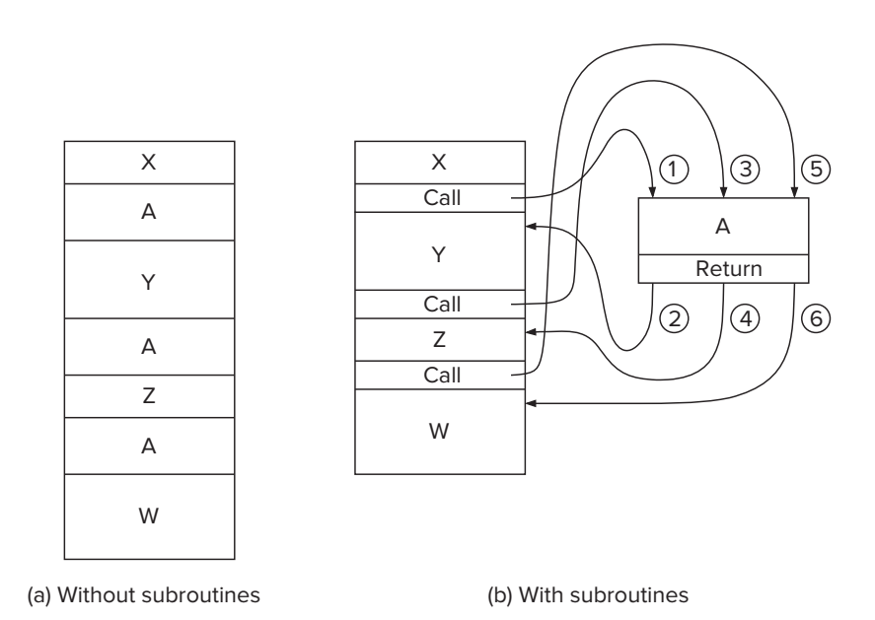
The Call/Return Mechanism

Slide 10
Control Instructions for Subroutines
15
14
13
12
11
10
9
8
7
6
5
4
3
2
1
0
BR
0
0
0
0
n
z
p
PCoffset9
JSR
0
1
0
0
1
PCoffset11
JSRR
0
1
0
0
0
0
0
BaseR
0
0
0
0
0
0
RTI
1
0
0
0
0
0
0
0
0
0
0
0
0
0
0
0
JMP
1
1
0
0
0
0
0
BaseR
0
0
0
0
0
0
RET
1
1
0
0
0
0
0
1
1
1
0
0
0
0
0
0
TRAP
1
1
1
1
0
0
0
0
TrapVector8

Slide 11
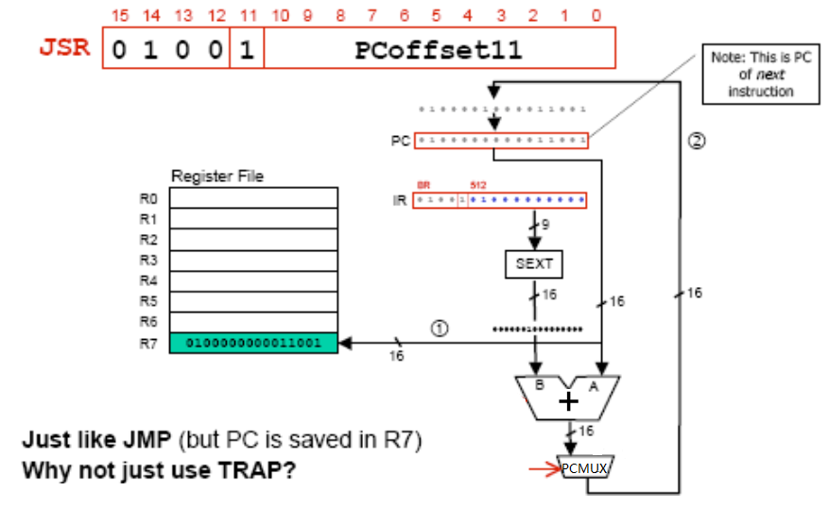
JSR

Slide 12
F
D
EA
JSR (PC-Relative)
OP
₁₆
GatePC
₁₆
GateMARMUX
EX
LD.PC
PC
DR
₃
MARMUX
+1
REG FILE
₁₆
₂
PCMUX
₁₆
₁₆
₁₆
₁₆
₁₆
LD.REG
S
[7:0]
SR2
SR2
OUT
SR1
OUT
SR1
SEXT
₊
₃
₃
ADDR2MUX
MUX
MUX
ADDR1MUX
₁₆
₁₆
[10:0]
₁₆
₁₆
₁₆
₁₆
₁₆
SEXT
[8:0]
LD.CC
₁₆
SEXT
FINITE STATE MACHINE
SR2MUX
[5:0]
SEXT
₁₆
N
Z
P
ALUK
_{A}
_{B}
[4:0]
SEXT
₂
ALU
LD.IR
IR
LOGIC
…
₁₆
₁₆
₁₆
RUN
GateALU
₁₆
GateMDR
₁₆
LD.MDR
MDR
MEMORY
MAR
LD.MAR
₁₆
INPUT
OUTPUT
MIO.EN
MUX
₁₆
MEM.EN,R,W

Slide 13
F
D
EA
JSR (PC-Relative)
OP
₁₆
GatePC
₁₆
GateMARMUX
EX
LD.PC
PC
DR
₃
MARMUX
+1
REG FILE
₁₆
₂
PCMUX
₁₆
₁₆
₁₆
₁₆
₁₆
LD.REG
S
[7:0]
SR2
SR2
OUT
SR1
OUT
SR1
SEXT
₊
₃
₃
ADDR2MUX
MUX
MUX
ADDR1MUX
₁₆
₁₆
[10:0]
₁₆
₁₆
₁₆
₁₆
₁₆
SEXT
[8:0]
LD.CC
₁₆
SEXT
FINITE STATE MACHINE
SR2MUX
[5:0]
SEXT
₁₆
N
Z
P
ALUK
_{A}
_{B}
[4:0]
SEXT
₂
ALU
LD.IR
IR
LOGIC
…
₁₆
₁₆
₁₆
RUN
GateALU
₁₆
GateMDR
₁₆
LD.MDR
MDR
MEMORY
MAR
LD.MAR
₁₆
INPUT
OUTPUT
MIO.EN
MUX
₁₆
MEM.EN,R,W

Slide 14
F
D
EA
JSR (PC-Relative)
OP
₁₆
GatePC
₁₆
GateMARMUX
EX
LD.PC
PC
DR
₃
MARMUX
+1
REG FILE
₁₆
₂
PCMUX
₁₆
₁₆
₁₆
₁₆
₁₆
LD.REG
S
[7:0]
SR2
SR2
OUT
SR1
OUT
SR1
SEXT
₊
₃
₃
ADDR2MUX
MUX
MUX
ADDR1MUX
₁₆
₁₆
[10:0]
₁₆
₁₆
₁₆
₁₆
₁₆
SEXT
[8:0]
LD.CC
₁₆
SEXT
FINITE STATE MACHINE
SR2MUX
[5:0]
SEXT
₁₆
N
Z
P
ALUK
_{A}
_{B}
[4:0]
SEXT
₂
ALU
LD.IR
IR
LOGIC
…
₁₆
₁₆
₁₆
RUN
GateALU
₁₆
GateMDR
₁₆
LD.MDR
MDR
MEMORY
MAR
LD.MAR
₁₆
INPUT
OUTPUT
MIO.EN
MUX
₁₆
MEM.EN,R,W

Slide 15
JSR (PC-Relative)
F
D
EA
OP
EX
S
₁₆
GatePC
₁₆
GateMARMUX
LD.PC
PC
DR
₃
MARMUX
+1
REG FILE
₁₆
₂
PCMUX
₁₆
₁₆
₁₆
₁₆
₁₆
LD.REG
[7:0]
SR2
SR2
OUT
SR1
OUT
SR1
SEXT
₊
₃
₃
ADDR2MUX
MUX
MUX
ADDR1MUX
₁₆
₁₆
[10:0]
₁₆
₁₆
₁₆
₁₆
₁₆
SEXT
[8:0]
LD.CC
₁₆
SEXT
FINITE STATE MACHINE
SR2MUX
[5:0]
SEXT
₁₆
N
Z
P
ALUK
_{A}
_{B}
[4:0]
SEXT
₂
ALU
LD.IR
IR
LOGIC
…
₁₆
₁₆
₁₆
RUN
GateALU
₁₆
GateMDR
₁₆
LD.MDR
MDR
MEMORY
MAR
LD.MAR
₁₆
INPUT
OUTPUT
MIO.EN
MUX
₁₆
MEM.EN,R,W

Slide 16
JSR (PC-Relative)
F
D
EA
OP
EX
S
₁₆
GatePC
₁₆
GateMARMUX
LD.PC
PC
DR
₃
MARMUX
+1
REG FILE
₁₆
₂
PCMUX
₁₆
₁₆
₁₆
₁₆
₁₆
LD.REG
[7:0]
SR2
SR2
OUT
SR1
OUT
SR1
SEXT
₊
₃
₃
ADDR2MUX
MUX
MUX
ADDR1MUX
₁₆
₁₆
[10:0]
₁₆
₁₆
₁₆
₁₆
₁₆
SEXT
[8:0]
LD.CC
₁₆
SEXT
FINITE STATE MACHINE
SR2MUX
[5:0]
SEXT
₁₆
N
Z
P
ALUK
_{A}
_{B}
[4:0]
SEXT
₂
ALU
LD.IR
IR
LOGIC
…
₁₆
₁₆
₁₆
RUN
GateALU
₁₆
GateMDR
₁₆
LD.MDR
MDR
MEMORY
MAR
LD.MAR
₁₆
INPUT
OUTPUT
MIO.EN
MUX
₁₆
MEM.EN,R,W

Slide 17
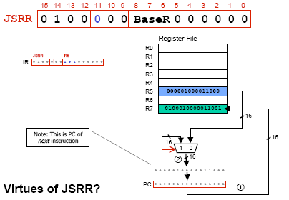
JSRR

Slide 18
F
D
EA
JSRR (Register)
OP
₁₆
GatePC
₁₆
GateMARMUX
EX
LD.PC
PC
DR
₃
MARMUX
+1
REG FILE
₁₆
₂
PCMUX
₁₆
₁₆
₁₆
₁₆
₁₆
LD.REG
S
[7:0]
SR2
SR2
OUT
SR1
OUT
SR1
SEXT
₊
₃
₃
ADDR2MUX
MUX
MUX
ADDR1MUX
₁₆
₁₆
[10:0]
₁₆
₁₆
₁₆
₁₆
₁₆
SEXT
[8:0]
LD.CC
₁₆
SEXT
FINITE STATE MACHINE
SR2MUX
[5:0]
SEXT
₁₆
N
Z
P
ALUK
_{A}
_{B}
[4:0]
SEXT
₂
ALU
LD.IR
IR
LOGIC
…
₁₆
₁₆
₁₆
RUN
GateALU
₁₆
GateMDR
₁₆
LD.MDR
MDR
MEMORY
MAR
LD.MAR
₁₆
INPUT
OUTPUT
MIO.EN
MUX
₁₆
MEM.EN,R,W

Slide 19
F
D
EA
JSRR (Register)
OP
₁₆
GatePC
₁₆
GateMARMUX
EX
LD.PC
PC
DR
₃
MARMUX
+1
REG FILE
₁₆
₂
PCMUX
₁₆
₁₆
₁₆
₁₆
₁₆
LD.REG
S
[7:0]
SR2
SR2
OUT
SR1
OUT
SR1
SEXT
₊
₃
₃
ADDR2MUX
MUX
MUX
ADDR1MUX
₁₆
₁₆
[10:0]
₁₆
₁₆
₁₆
₁₆
₁₆
SEXT
[8:0]
LD.CC
₁₆
SEXT
FINITE STATE MACHINE
SR2MUX
[5:0]
SEXT
₁₆
N
Z
P
ALUK
_{A}
_{B}
[4:0]
SEXT
₂
ALU
LD.IR
IR
LOGIC
…
₁₆
₁₆
₁₆
RUN
GateALU
₁₆
GateMDR
₁₆
LD.MDR
MDR
MEMORY
MAR
LD.MAR
₁₆
INPUT
OUTPUT
MIO.EN
MUX
₁₆
MEM.EN,R,W

Slide 20
F
D
EA
JSRR (Register)
OP
₁₆
GatePC
₁₆
GateMARMUX
EX
LD.PC
PC
DR
₃
MARMUX
+1
REG FILE
₁₆
₂
PCMUX
₁₆
₁₆
₁₆
₁₆
₁₆
LD.REG
S
[7:0]
SR2
SR2
OUT
SR1
OUT
SR1
SEXT
₊
₃
₃
ADDR2MUX
MUX
MUX
ADDR1MUX
₁₆
₁₆
[10:0]
₁₆
₁₆
₁₆
₁₆
₁₆
SEXT
[8:0]
LD.CC
₁₆
SEXT
FINITE STATE MACHINE
SR2MUX
[5:0]
SEXT
₁₆
N
Z
P
ALUK
_{A}
_{B}
[4:0]
SEXT
₂
ALU
LD.IR
IR
LOGIC
…
₁₆
₁₆
₁₆
RUN
GateALU
₁₆
GateMDR
₁₆
LD.MDR
MDR
MEMORY
MAR
LD.MAR
₁₆
INPUT
OUTPUT
MIO.EN
MUX
₁₆
MEM.EN,R,W

Slide 21
JSRR (Register)
F
D
EA
OP
EX
S
₁₆
GatePC
₁₆
GateMARMUX
LD.PC
PC
DR
₃
MARMUX
+1
REG FILE
₁₆
₂
PCMUX
₁₆
₁₆
₁₆
₁₆
₁₆
LD.REG
[7:0]
SR2
SR2
OUT
SR1
OUT
SR1
SEXT
₊
₃
₃
ADDR2MUX
MUX
MUX
ADDR1MUX
₁₆
₁₆
[10:0]
₁₆
₁₆
₁₆
₁₆
₁₆
SEXT
[8:0]
LD.CC
₁₆
SEXT
FINITE STATE MACHINE
SR2MUX
[5:0]
SEXT
₁₆
N
Z
P
ALUK
_{A}
_{B}
[4:0]
SEXT
₂
ALU
LD.IR
IR
LOGIC
…
₁₆
₁₆
₁₆
RUN
GateALU
₁₆
GateMDR
₁₆
LD.MDR
MDR
MEMORY
MAR
LD.MAR
₁₆
INPUT
OUTPUT
MIO.EN
MUX
₁₆
MEM.EN,R,W

Slide 22
JSRR (Register)
F
D
EA
OP
EX
S
₁₆
GatePC
₁₆
GateMARMUX
LD.PC
PC
DR
₃
MARMUX
+1
REG FILE
₁₆
₂
PCMUX
₁₆
₁₆
₁₆
₁₆
₁₆
LD.REG
[7:0]
SR2
SR2
OUT
SR1
OUT
SR1
SEXT
₊
₃
₃
ADDR2MUX
MUX
MUX
ADDR1MUX
₁₆
₁₆
[10:0]
₁₆
₁₆
₁₆
₁₆
₁₆
SEXT
[8:0]
LD.CC
₁₆
SEXT
FINITE STATE MACHINE
SR2MUX
[5:0]
SEXT
₁₆
N
Z
P
ALUK
_{A}
_{B}
[4:0]
SEXT
₂
ALU
LD.IR
IR
LOGIC
…
₁₆
₁₆
₁₆
RUN
GateALU
₁₆
GateMDR
₁₆
LD.MDR
MDR
MEMORY
MAR
LD.MAR
₁₆
INPUT
OUTPUT
MIO.EN
MUX
₁₆
MEM.EN,R,W

Slide 23
RET instruction
RET – return instruction
  How to return
    Place address in R7 in PC, Return the execution to the last calling point.
  PC ← (R7)
15 14 13 12
11 10 9 8 7 6
5 4 3 2 1 0
RET
(JMP R7)
1 1 0 0
0 0 0
1 1 1
0 0 0 0 0 0

Slide 24
Example: Negate the value in R0
TwosComp NOT R0,R0 ;flip bits
ADD R0,R0,#1 ;add one
RET ;return to caller
To call from a program
;need to compute R4 = R1-R3
ADD R0,R3,#0 ;copy R3 to R0
JSR TwosComp ;negate
ADD R4,R1,R0 ;add to R1
...

Slide 25
Using Subroutines
Programmer must know
  Address: or at least a label that will be bound to its address
  Function: what it does
    NOTE: The programmer does not need to know how the subroutine works, but what changes are visible in the machine’s state after the routine has run
  Arguments: what they are and where they are placed
  Return values: what they are and where they are placed
TwosComp NOT R0,R0 ;flip bits
ADD R0,R0,#1 ;add one
RET ;return to caller
;need to compute R4 = R1-R3
ADD R0,R3,#0 ;copy R3 to R0
JSR TwosComp ;negate
ADD R4,R1,R0 ;add to R1

Slide 26
Passing Information To Subroutines
Argument(s)
  Value passed in to a subroutine is called an argument
  This is a value needed by the subroutine to do its job
  Examples
    TwosComp: R0 is number to be negated
    OUT: R0 is character to be printed
    PUTS: R0 is address of string to be printed
How?
  In registers (simple, fast, but limited number)
  In memory (many, but awkward, expensive)
  Both

Slide 27
Getting Values From Subroutines
Return Values
  A value passed out of a subroutine is called a return value
  This is the value that you called the subroutine to compute
  Examples
    TwosComp: negated value is returned in R0
    GETC: character read from the keyboard is returned in R0
How?
  Registers, memory, or both
  Single return value in register most common

Slide 28
Saving and Restore Registers
Like service routines, must save and restore registers
  Who saves what is part of the calling convention
Generally use “callee-save” strategy, except for return values
  Same as trap service routines
  Save anything that subroutine alters internally that shouldn’t be visible when the subroutine returns
  Restore incoming arguments to original values (unless overwritten by return value)
Remember
  You MUST save R7 if you call any other subroutine or trap
  Otherwise, you won’t be able to return!

Slide 29
Subroutine Template
01 SUB_NAME
02 ;Register Saving
03 ST R0, SUB_R0
04 ST R1, SUB_R1
05 …
06 ST R6, SUB_R6
07 ST R7, SUB_R7;Return address
08
09 ;***Code***
10
11 ;Register Restoring
12 LD R0, SUB_R0
13 LD R1, SUB_R1
14 …
15 LD R6, SUB_R6
16 LD R7, SUB_R7 ;Return address
17 RET

